Slide 1
History of Human Computer Interaction
Where did HCI innovations and philosophy come from?
Who were the major personalities?
What were the important systems?
How did ideas move from the laboratory to the market?
This slides have been developed by The CHILAB at the Samuel Ginn College of Engineering
Auburn University
Credit to:
Dr. Sheryl D. Seals, the lab research assistants

Slide 2
Key People
People
  Vannevar Bush
  J. R. (Lick) Licklider
  Ivan Sutherland
  Doug Engelbart
  Alan Kay
  Ted Nelson
  Nicholas Negroponte
  Mark Weiser
  Jaron Lanier

Slide 3
History of HCI
Input/output devices
Input Output
  Early days connecting wires lights on display
  paper tape & punch cards paper
  keyboard teletype
  Today keyboard scrolling glass teletype
  + cursor keys character terminal
  + mouse bit-mapped screen
  + microphone audio
  Soon? data gloves + suits head-mounted displays
  computer jewelry ubiquitous computing
  natural language autonomous agents
  cameras multimedia
The lesson
  keyboards & terminals are just artifacts of today’s technologies
  new input/output devices will change the way we interact with computers

Slide 4
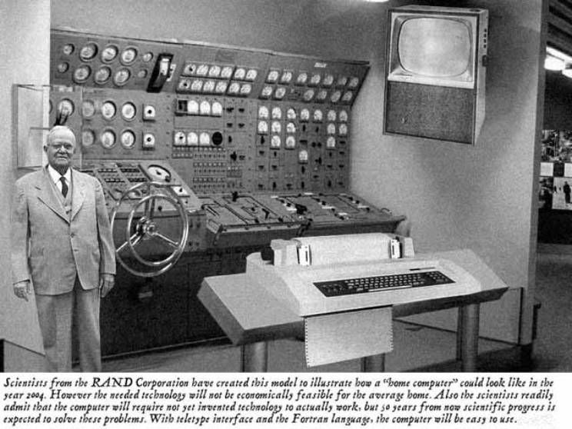
History of HCI
RAND’s vision of the future
From ImageShack web site //www.imageshack.us ; original source unknown

Slide 5
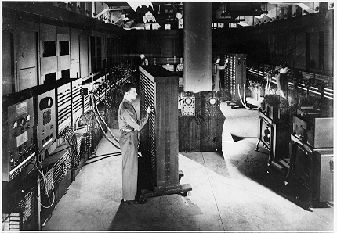
History of HCI
Eniac (1943)
  A general view of the ENIAC, the world's first all electronic numerical integrator and computer.
Electronic Numerical Integrator And Computer
From IBM Archives.

Slide 6
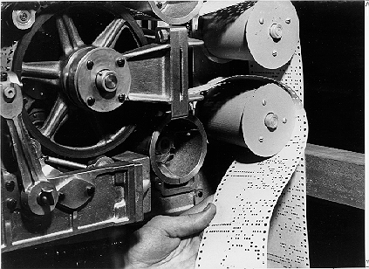
History of HCI
Mark I (1944)
  The Mark I paper tape readers.
The Los Alamos group completed
its work in a much shorter time
than the Cambridge group. However,
the punched-card machine operation
computed values to six decimal places,
whereas the Mark I computed values
to eighteen decimal places. Additionally,
Mark I integrated the partial
differential equation at a much
smaller interval size [or smaller mesh]
and so...achieved far greater precision
From Harvard University Cruft Photo Laboratory.

Slide 7
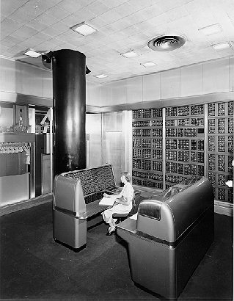
History of HCI
IBM SSEC (1948)
Selective Sequence Electronic Calculator
From IBM Archives.

Slide 8
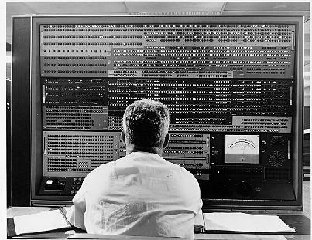
History of HCI
Stretch (1961) The IBM 7030
  A close-up of the Stretch technical control panel.
  IBM's first transistorized supercomputer. Originally designed to meet a requirement formulated by Edward Teller at Lawrence Livermore (LLNL)
From IBM Archives.

Slide 9
History of HCI
Intellectual foundations
Vannevar Bush (1945)
  “As we may think” article in Atlantic Monthly
  Identified the information storage and retrieval problem:
  new knowledge does not reach the people who could benefit from it
  “publication has been extended far beyond our present ability to make real use of the record”

Slide 10
History of HCI
Bush’s Memex
Conceiving Hypertext and the World Wide Web
  a device where individuals stores all personal books, records, communications etc
  items retrieved rapidly through indexing, keywords, cross references,...
  can annotate text with margin notes, comments...
  can construct and save a trail (chain of links) through the material
  acts as an external memory!
Bush’s Memex based on microfilm records!
  but not implemented
mmmm mmmm
mmm mm
mmmm mmmm
mmm mm
mmmm mmm
mmmm mmmm
mmm mm
mmmm mmm
mmmm mmmm
mmm mm
mmmm mmm
mmmm mmm

Slide 11
History of HCI
J.C.R. Licklider (1960)
Outlined “man-computer symbiosis”
  “The hope is that, in not too many years, human brains and computing machines will be coupled together very tightly and that the resulting partnership will think as no human brain has ever thought and process data in a way not approached by the information-handling machines we know today.”

Slide 12
History of HCI
J.C.R. Licklider (continued)
Produced goals that are pre-requisite to “man-computer symbiosis”
Immediate goals:
  time sharing of computers among many users
  electronic i/o for the display and communication of symbolic and pictorial information
  interactive real time system for information processing and programming
  large scale information storage and retrieval

Slide 13
History of HCI
J.C.R. Licklider (continued)
intermediate goals:
  facilitation of human cooperation in the design & programming of large systems
  combined speech recognition, hand-printed character recognition & light-pen editing
long term visions:
  natural language understanding (syntax, semantics, pragmatics)
  speech recognition of arbitrary computer users
  heuristic programming

Slide 14


History of HCI
Significant Advances 1960 - 1980
Mid ‘60s
  computers too expensive for a single person
Time-sharing
  the illusion that each user was on their own personal machine
  led to immediate need to support human-computer interaction
    dramatically increased accessibility of machines
    afforded interactive systems and languages vs batch “jobs”
    community as a whole communicated through computers
    (and eventually through networks) via email, shared files, etc.

Slide 15
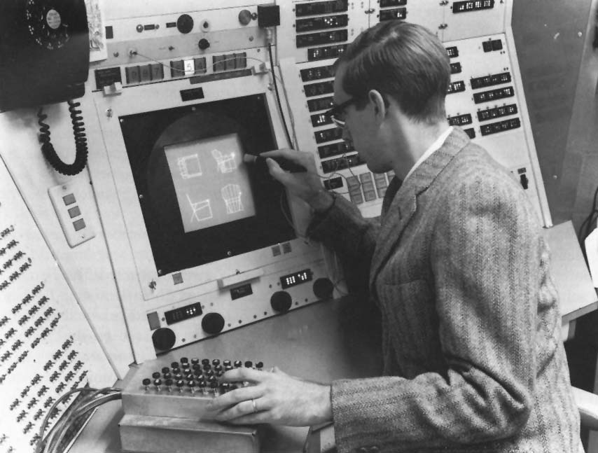
History of HCI
Ivan Sutherland’s SketchPad-1963 PhD
Sophisticated drawing package
  introduced many ideas/concepts now found in today’s interfaces
    hierarchical structures defined pictures and sub-pictures
    object-oriented programming: master picture with instances
    constraints: specify details which the system maintains through changes
    icons: small pictures that represented more complex items
    copying: both pictures and constraints
    input techniques: efficient use of
    light pen
    world coordinates: separation of
    screen from drawing coordinates
    recursive operations: applied to
    children of hierarchical objects
From http://accad.osu.edu/~waynec/history/images/ivan-sutherland.jpg

Slide 16
History of HCI
Ivan Sutherland’s SketchPad-1963 PhD
Parallel developments in hardware:
  “low-cost” graphics terminals
  input devices such as data tablets (1964)
  display processors capable of real-time manipulation of images (1968)

Slide 17
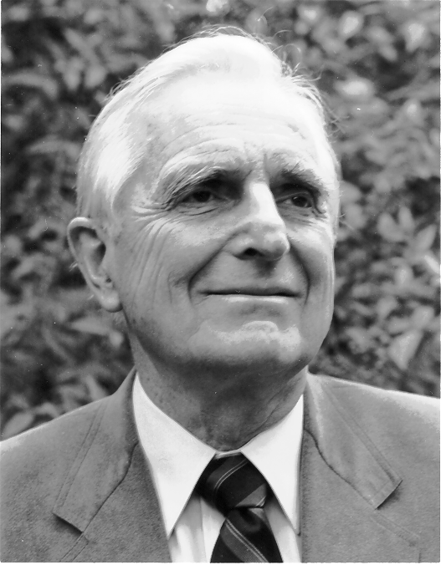
History of HCI
Douglas Engelbart
The Problem (early ‘50s)
  “...The world is getting more complex, and problems are getting more urgent. These must be dealt with collectively. However, human abilities to deal collectively with complex / urgent problems are not increasing as fast as these problems.
  If you could do something to improve
  human capability to deal with these
  problems, then you'd really contribute
  something basic.”
  ...Doug Engelbart
Notes:
In the very early 1950's, Doug had just become engaged. He
realized that he had achieved all his personal goals, but
had not yet articulated his work goals.
He thought hard about what problems were worth solving in
terms of its benefit to mankind. To paraphrase, he came up
with the following problem statement.
[READ FROM SLIDE]

Slide 18
History of HCI
Douglas Engelbart
The Vision (Early 50’s)
  …I had the image of sitting at a big CRT screen with all kinds of symbols, new and different symbols, not restricted to our old ones. The computer could be manipulated, and you could be operating all kinds of things to drive the computer
  ... I also had a clear picture that one's colleagues could be sitting in other rooms with similar work stations, tied to the same computer complex, and could be sharing and working and collaborating very closely. And also the assumption that there'd be a lot of new skills, new ways of thinking that would evolve "
  ...Doug Engelbart
Notes:
While thinking about this, it suddenly flashed on him that,
[READ FROM SLIDE]

Slide 19
History of HCI
Douglas Engelbart
A Conceptual Framework for Augmenting Human Intellect (SRI Report, 1962)
    "By augmenting man's intellect we mean increasing the capability of a man to approach a complex problem situation, gain comprehension to suit his particular needs, and to derive solutions to problems.
    One objective is to develop new techniques, procedures, and systems that will better adapt people's basic information-handling capabilities to the needs, problems, and progress of society."
    ...Doug Engelbart
Notes:
To prepare himself for tackling this problem, he trained
himself in graduate
school, eventually joining the Stanford Research Institute. In
1962, he described in a landmark paper his
Conceptual Framework for Augmenting Human Intellect.
He wrote [READ FROM SLIDE]

Slide 20

History of HCI
The First Mouse (1964)
Notes:
Over the next 6 years, he created a team, acquired funding,
and started implementing his vision. Along the way, he and
his group invented the mouse, but as we will see this is
only a small part of the complete project.

Slide 21
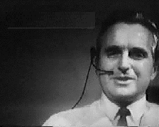
History of HCI
AFIP Fall Joint Conference, 1968
Document Processing
  modern word processing
  outline processing
  hypermedia
Input / Output
  the mouse and one-handed corded keyboard
  high resolution displays
  multiple windows
  specially designed furniture
Shared work
  shared files and personal annotations
  electronic messaging
  shared displays with multiple pointers
  audio/video conferencing
  ideas of an Internet
User testing, training
Notes:
This phase of his work peaked in 1968, where he took a
huge risk by deciding to present his ideas and the developing
NLS system in a live demonstration at the AFIP Fall Joint
Computer Conference.
Many concepts in today's interfaces were first introduced in the NLS
system and its presentation
Document Processing
modern word processing
outline processing
hypermedia

Slide 22
History of HCI
The Personal Computer
Alan Kay (1969)
  Dynabook vision (and cardboard prototype) of a notebook computer:
  “Imagine having your own self-contained knowledge manipulator in a portable package the size and shape of an ordinary notebook. Suppose it had enough power to out-race your senses of sight and hearing, enough capacity to store for later retrieval thousands of page-equivalents of reference materials, poems, letters, recipes, records, drawings, animations, musical scores...”
Ted Nelson
  1974: “Computer Lib/Dream Machines”
  popular book describing what computers can do for people (instead of business!)

Slide 23
History of HCI
The Personal Computer
Xerox PARC, mid-’70s
  Alto computer, a personal workstation
    local processor, bit-mapped display, mouse
  modern graphical interfaces
    text and drawing editing, electronic mail
    windows, menus, scroll bars, mouse selection, etc
  local area networks (Ethernet) for personal workstations
    could make use of shared resources
ALTAIR 8800 (1975)
  Popular electronics article that showed people
  how to build a computer for under $400

Slide 24
History of HCI
Commercial machines: Xerox Star-1981
First commercial personal computer designed for “business professionals”
First comprehensive GUI used many ideas developed at Xerox PARC
  familiar user’s conceptual model (simulated desktop)
  promoted recognizing/pointing rather than remembering/typing
  property sheets to specify appearance/behaviour of objects
  what you see is what you get (WYSIWYG)
  small set of generic commands that could be used throughout the system
  high degree of consistency and simplicity
  modeless interaction
  limited amount of user tailorability

Slide 25
History of HCI
Xerox Star (continued)
First system based upon usability engineering
  inspired design
  extensive paper prototyping and usage analysis
  usability testing with potential users
  iterative refinement of interface
Commercial failure
  cost ($15,000);
    IBM had just announced a less expensive machine
  limited functionality
    e.g., no spreadsheet
  closed architecture,
    3rd party vendors could not add applications
  perceived as slow
    but really fast!
  slavish adherence to direct manipulation

Slide 26
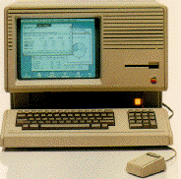
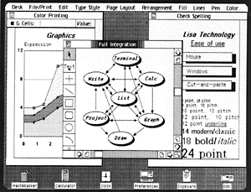
History of HCI
Commercial Machines: Apple Lisa (1983)
based upon many ideas in the Star
  predecessor of Macintosh,
  somewhat cheaper ($10,000)
  commercial failure as well
http://fp3.antelecom.net/gcifu/applemuseum/lisa2.html

Slide 27
History of HCI
Commercial Machines: Apple
Apple Macintosh (1984)
  “old ideas” but well done!
succeeded because:
  aggressive pricing ($2500)
  did not need to trailblaze
    learnt from mistakes of Lisa and corrected them; ideas now “mature”
    market now ready for them
  developer’s toolkit encouraged 3rd party non-Apple software
  interface guidelines encouraged consistency between applications
  domination in desktop publishing because of affordable laser printer and excellent graphics

Slide 28
History of HCI
Other events:
MIT Architecture Machine Group
  Nicholas Negroponte (1969-1980+)
  many innovative inventions, including
    wall sized displays
    use of video disks
    use of artificial intelligence in interfaces (idea of agents)
    speech recognition merged with pointing
    speech production
    multimedia hypertext
    ....
ACM SIGCHI (1982)
  special interest group on computer-human interaction
  conferences draw between 2000-3000 people
HCI Journals
  Int J Man Machine Studies (1969)
  many others since 1982

Slide 29
History of HCI
You know now:
HCI importance result of:
  cheaper/available computers/workstations meant people more important than machines
  excellent interface ideas modeled after human needs instead of system needs (user centered design)
  evolution of ideas into products through several generations
    pioneer systems developed innovative designs, but often commercially unviable
    settler systems incorporated (many years later) well-researched designs
  people no longer willing to accept products with poor interfaces

